Slide 1


Machine Learning-based Scientific Article Similarity Checking Research
Shinthiya Nowsain Promi ISIfmu-25
(e-mail: shinthiya-nowsain.promi@stud.vilniustech.lt )
Supervisor: Prof. Dr. Diana Kalibatienė
2026-01-20

Slide 2
Agenda
Introduction
Problem Domain
Aim and Tasks
Related Work Analysis
Literature Review: Taxonomy
Literature Review: Methodology Comparison
Literature Review: Findings
Possible Proposed Approach
Future Work
Conclusions

Slide 3
Introduction
Plagiarism is the act of taking someone else’s work, ideas, or writing and presenting them as your own without giving proper credit. This research explores how we can use Machine Learning to automatically check and compare scientific articles to see how similar they are.
Developing these advanced tools is vital for protecting the honesty of research and managing the huge number of academic papers being published today.

Slide 4
Problem Domain
How can we effectively detect semantic plagiarism in scientific articles given the complexity of domain specific jargon?
Object
Machine learning and Natural Language Processing (NLP) algorithms designed for semantic text similarity assessment in scientific literature.

Slide 5
Aim and Tasks
Aim:
To improve the detection of semantic plagiarism in scientific articles by developing a hybrid similarity checking model.
Tasks:
Analyze the related literature for the state-of-the-art text similarity detection methods.
Propose a scientific article similarity approach that combines semantic vector representations with syntactic alignment.
Implement the proposed approach and experimentally evaluate performance against baseline models.

Slide 6
Related Work Analysis
The related work analysis presents a systematic review of related scientific literatures, tracing the evolution of detection methodologies.
By comparing traditional methods against modern methods, a fundamental methodological shift was found. This analysis helps as the foundation for the proposed improvement by navigating through different methods.

Slide 7
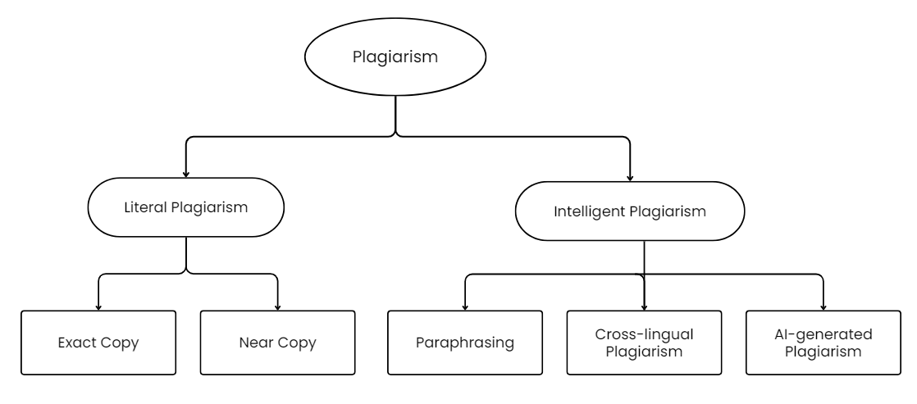
Literature Review: Taxonomy
Figure: Plagiarism Classification from (Amirzhanov et al., 2025; Lieharyani et al., 2025)

Slide 8
Literature Review: Methodology Comparison
Category | Approach | Strength | Limitations | Results
Traditional | Lexical & ML (SVM) | Fast, Interpretable | Fails at Paraphrasing | 96.5% accuracy
New (DL) | Sequential (LSTM) | Captures Word Order | Slow Training | Outperformed CNN-based models
Modern | Transformers (BERT) | Deep Semantic Meaning | Resource Intensive | 99.5% accuracy (near-perfect)

Slide 9
Literature Review: Findings
Traditional models are far too primitive to understand nuanced plagiarism
New deep learning models are able to understand context and meaning of the writing
The analysis shows a decisive shift toward Hybrid Transformer Models that combine semantic power with structural alignment precision.
Combining the semantic power of transformer-based architectures (BERT) with the structural precision of sequence alignment algorithms
Most suitable for scientific articles, in order to understand the smallest semantic shifts, splitting and reordering

Slide 10
Possible Proposed Approach
Transformer Based Models + Sequential Deep Learning Models
(BERT/ DistilBERT) + (LSTM / RNN / Smith-Waterman)
Semantic Meaning + Sequence / order Checking

Slide 11
Future Work
Further deep dive on the hybrid transformer model and how they work
Research the related literatures and select specific model
Research on which datasets are best for the case in question and which ones need to be normalized accordingly

Slide 12
Conclusions
Current assessments of text similarity detection show that traditional approaches cannot adequately identify advanced scientific plagiarism. Transformer-based models, notably BERT, can be seen as the premier current solution. Hybrid models show the most promising result and detect nuances from scientific texts. These models' ability to process bidirectional context allows for the precise detection of subtle semantic manipulations that define modern intelligent plagiarism.

Slide 13
References
Amirzhanov, A., Turan, C., & Makhmutova, A. (2025). Plagiarism types and detection methods: A systematic survey of algorithms in text analysis. Frontiers in Computer Science, 7, Article 1504725. https://doi.org/10.3389/fcomp.2025.1504725
Lieharyani, D. C. U., Hutahaean, J., Nugraha, A. C., Suprihanto, & Pribadi, D. S. (2025). The context similarity problem in academic plagiarism detection: A case study on differentiating originality from collusion in a homogeneous dataset. E3S Web of Conferences, 664, Article 01004. https://doi.org/10.1051/e3sconf/202566401004

Slide 14
Thank you. Questions?

